Slide 1
Churn Prediction
TEAM MENTOR: MR. ASHWIN PERTI
TEAM MEMBERS: ANANT KUMAR
ADITYA SINGH
MOHD. AFTAB ALAM
Team Name: Machine Runner

Slide 2
INTRODUCTION
Churn is a one of the biggest problem in the SME.
In recent years, post-liberalization of the energy market in Europe. ElectricCo has had a growing problem with increasing customer defections above industry average.
They would like to identify the drivers of this problem and to devise and implement a strategy to counter it.
The churn issue is most acute in the SME division and thus they want it to be the first priority.
The head of the SME division has asked whether it is possible to predict the customers which are most likely to churn so that they can trial a range of pre-emptive actions.

Slide 3
ABSTRACT.
The first stage is to establish the viability of such a model.
For training model we are provided with a dataset which includes features of SME customers in January 2016 as well as the information about whether or not they have churned by March 2016 on training output dataset.
It is done in 3 statges:
Data Analysis and visualization
Data Preprocessing and feature scaling
Machine learning Algorithm
We take training data as features and training output as training labels and done training, validation and testing.
At last we create Model.

Slide 4
INTRODUCTION contd.
Using the trained model you shall “score” customers in the verification data set (provided in the eponymous file) and put them in descending order of the propensity to churn.
You should also classify these customers into two classes:-
those which you predict to churn are to be labelled "1“;
and the remaining customers should be labelled "0" in the result template.

Slide 5
Information contained in the data set
The below table describes all the data fields which are found in the data (across three files). You will notice that the contents of some fields are meaningless text strings.
This is due to "hashing" of text fields for data privacy.
While their commercial interpretation is lost as a result of the hashing, they may still have predictive power.
A whole host of rich investigations are possible. Your ideas on what some next steps could be, armed with such data is also of interest.

Slide 6
Data Source
We are going to use the SME churn Data that we can find this dataset on this link
http://cbse.abes.ac.in/hack/Hackathon.html.

Slide 7
Libraries Used
pandas
Numpy
Seaborn
Matplotlib.pyplot
plotly
Scikit learn

Slide 8
Proposed.
Proposed method
Data analysis using Pandas
Data Visualization
Featuring scaling using standardscaler
Kfold Cross validation
SVM
LSVM
Logistic regession
Linear regression
Naive bayes
Decision tree
Perceptron
Ranomforest
SGD

Slide 9
Experimental Results and Discussion
Technologies used :
1.Windows 10 machine : Intel i5 processor clocked 2.4Ghz with 8GB RAM
2.Jupyter Notebook, Python 3.5.2, Skearn framework
3.NVIDIA Gtx 1060 6gb ram Graphic card.

Slide 10
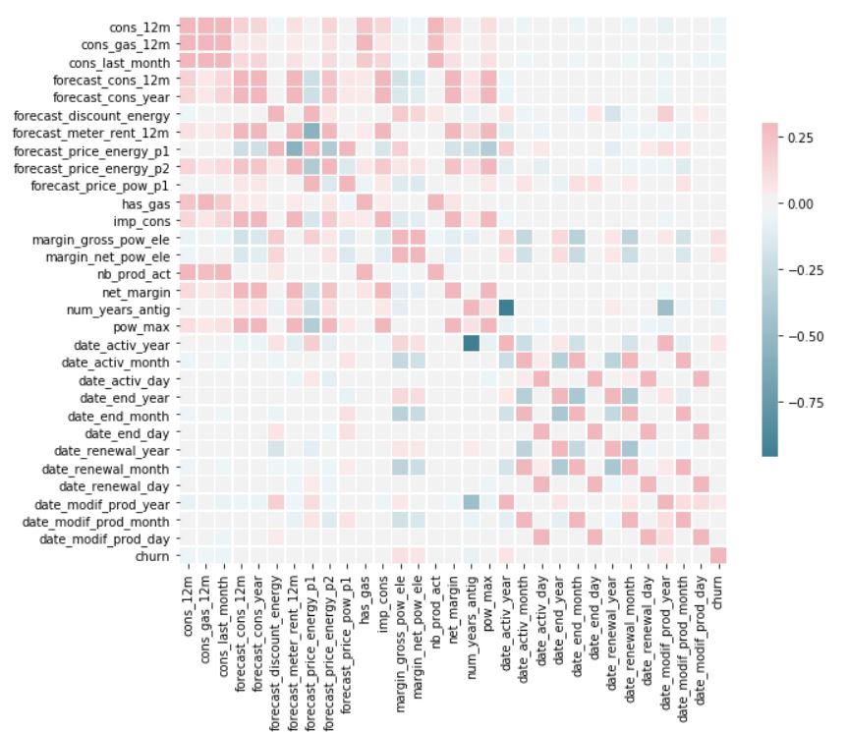
Correlation matrix

Slide 11
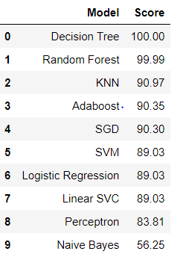
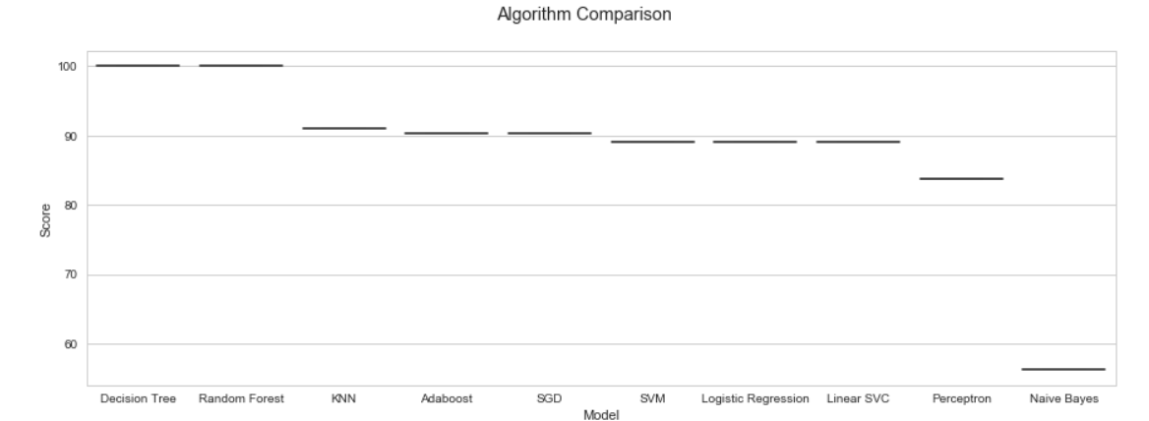
Conclution
This model is capable of predicting churn.
We make the final submision of dataframe into .csv format.

